Slide 1
Quale opzione preferire nella chirurgia di revisione?
MATTEO UCCELLI
Chirurgia generale ed oncologica
Centro di Chirurgia dell’obesita’
Direttore: S. Olmi
POLICLINICO SAN MARCO GSD – ZINGONIA (BG)

Slide 2
Tipologia delle procedure eseguite dal 2012 al 2023
Negli ultimi 10 anni: 212.684 bariatrici
105.278
Sleeve Gastrectomy
(quasi 50%)
La chirurgia di revisione più comune è su una LSG

Slide 3
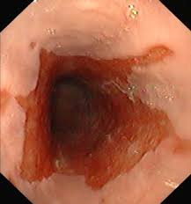
Chirurgia bariatrica di revisione
Fallimento (insufficient weight loss or weight regain)
GERD post bariatrica – GERD post LSG
 | POST-SLEEVE
GERD | 8 – 76 %
Esofagite | 15 – 41 %
Uso di PPI | 70 %
Barrett | 8 – 18.8 %
Tubulo ad alta pressione
Alterazione angolo di His
Disfunzione del LES
Fondo gastrico in eccesso
Ernia jatale post operatoria
Abitudini alimentari scorrette
Dilatazione del tubulo
Fondo gastrico in eccesso
Tubulo «largo»
Eccessiva distanza dal piloro
Indicazione a chirurgia primaria
Abitudini alimentari scorrette
WR post post bariatrica
3.2 – 35.1 %
WR post LSG
17.3 – 35.1 %
GERD post LSG 8 – 76 %
BE 8 % - 18.8 %
Franken RJ, et al. Treatment Options for Weight Regain or Insufficient Weight Loss After Sleeve Gastrectomy: a Systematic Review and Meta-analysis. Obes Surg. 2022 Jun;32(6):2035-2046.
Athanasiadis DI et al. Factors associated with weight regain post-bariatric surgery: a systematic review. Surg Endosc. 2021 Aug;35(8):4069-4084.
Brethauer S et al. Systematic review on reoperative bariatric surgery: American Society for Metabolic and Bariatric Surgery Revision Task Force. Surg Obes Relat Dis. 2014 Sep-Oct;10(5):952-72.
Chiu S et al. Effect of sleeve gastrectomy on gastroesophageal reflux disease: a sistematic review. Surg Obes Relat Disease 2011;7(4):510-5
Kindel TL et al. The Improvement of Gastroesophageal Reflux Disease and Barrett's after Bariatric Surgery. Obes Surg. 2016 Apr;26(4):718
Howard et al, Surg Obes Relat Dis, 2011; Brandon A, Obes Surg, 2018; Gorodner V, Obes Surg, 2018; Kindel TL et al. Obes Surg. 2016

Slide 4
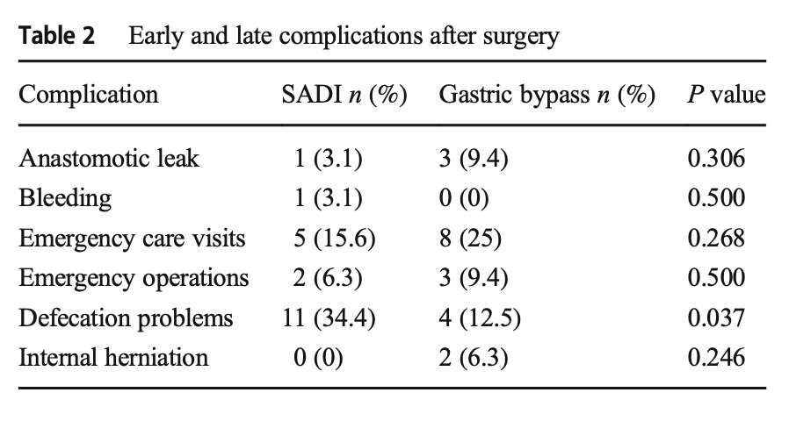
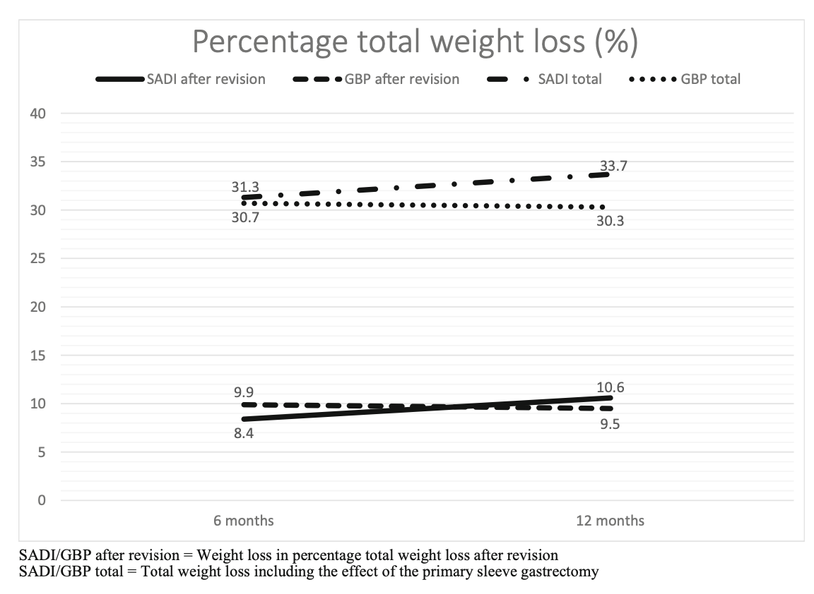
Ceha CMM, van Wezenbeek MR, Versteegden DPA, Smulders JF, Nienhuijs SW. Matched Short-Term Results of SADI Versus GBP After Sleeve Gastrectomy. Obes Surg. 2018 Dec;28(12):3809-3814. doi: 10.1007/s11695-018-3415-5. PMID: 30039236.
SADI appears to be a promising surgical method. It seems to be a safer procedure in terms of complications considering it to be advanced bariatric surgery. The results are good (equal or better than the GBP at some points) in a short-term follow-up; however, a longer follow-up period and larger study population are needed to determine its full potential.
Ceha CMM, van Wezenbeek MR, Versteegden DPA, Smulders JF, Nienhuijs SW. Matched Short-Term Results of SADI Versus GBP After Sleeve Gastrectomy. Obes Surg. 2018 Dec;28(12):3809-3814.

Slide 5
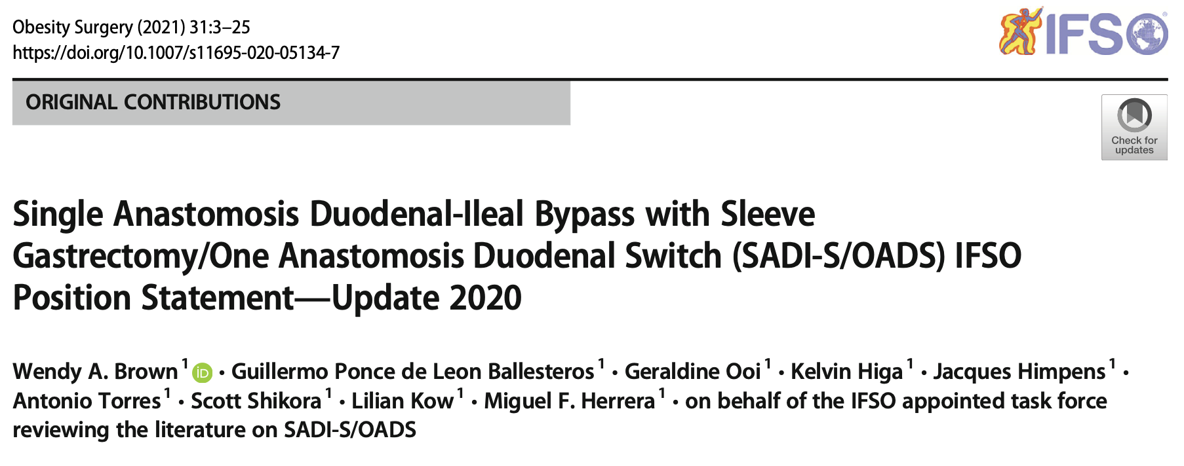
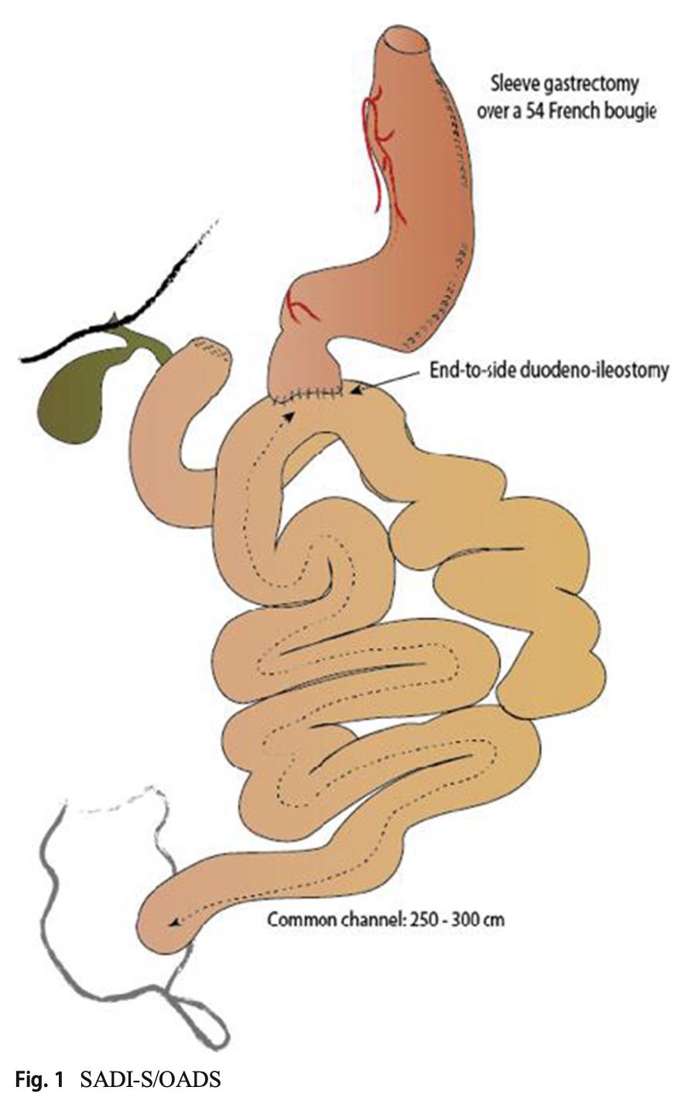
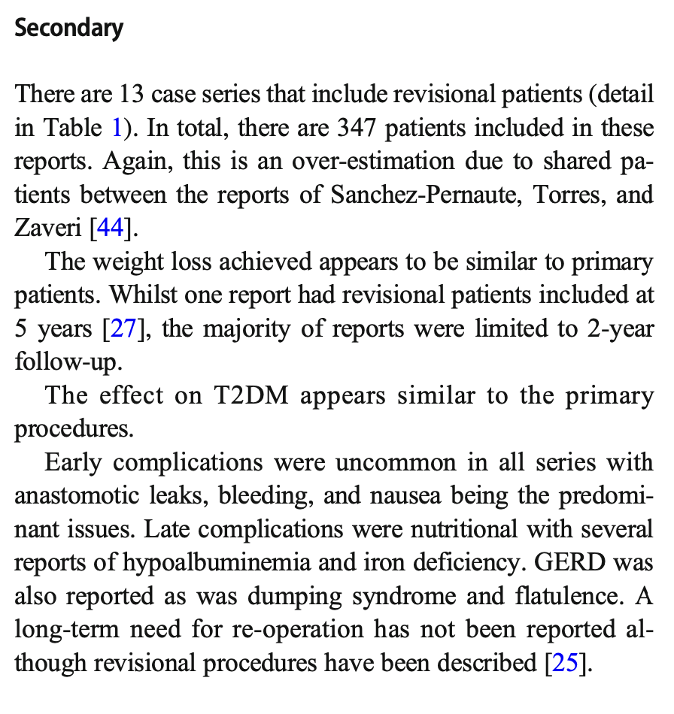
Revisional procedures
Two-step’s procedure in young patients (age < 40 years) and/or challenging/complex cases
Inadequate weight loss and/or weight regain after sleeve gastrectomy and in other selected cases
Absolute contraindications are:
Barrett’s esophagus
Severe gastro-esophageal reflux disease
Hiatal hernia (major > 4 cm)
In conclusion, SADI-S is a safe procedure, thanks to its low rate of early complications. Our experience confirms the reproducibility of the technique, provided that it is performed in referral centers. So we can conclude that it can be one of the procedures of choice in the treatment of superobese patient and in case of failed results after sleeve gastrectomy.
Pennestrì F, Sessa L, Prioli F, Salvi G, Gallucci P, Ciccoritti L, Greco F, De Crea C, Raffaelli M. Single anastomosis duodenal-ileal bypass with sleeve gastrectomy (SADI-S): experience from a high-bariatric volume center. Langenbecks Arch Surg. 2022 Aug;407(5):1851-1862.

Slide 6
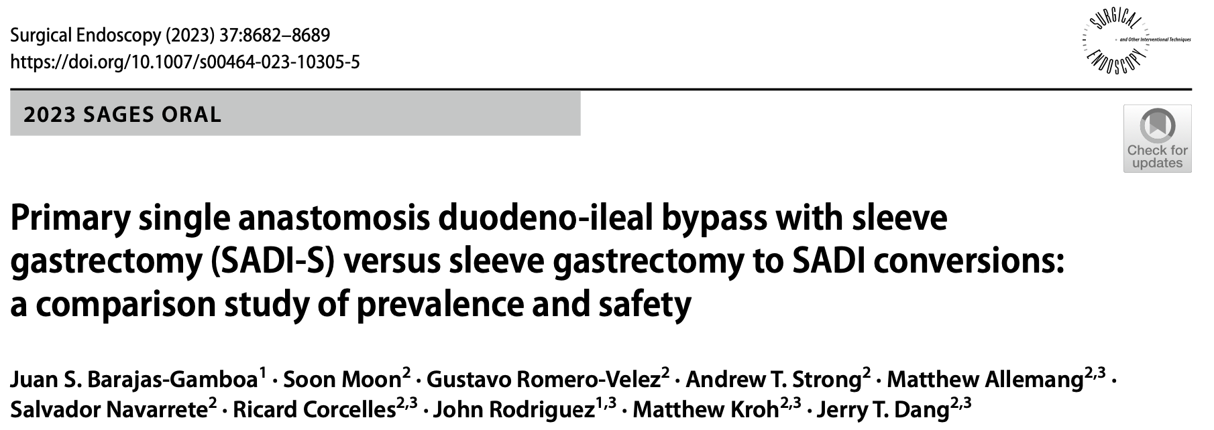
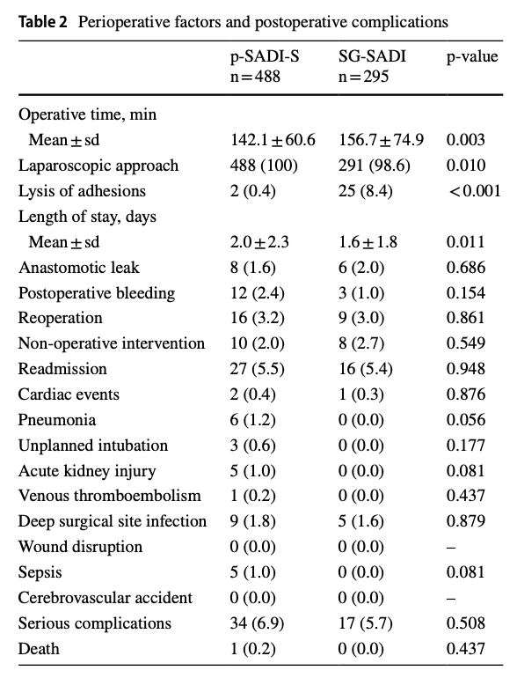
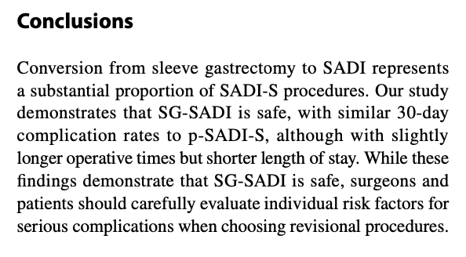
SADI primaria (p-SADI-S): 488 pazienti
From LSG to SADI (SG-SADI): 295 pazienti
The unique technical aspects of SG to SADI conversion may explain the improved safety profile compared to other conversion options. The primary areas of surgical dissection and bowel manipulation in the SG to SADI occur away from the areas handled (and thus likely scarred) during a primary sleeve operation. Other surgical options for conversion from sleeve include RYGB and one anastomosis gastric bypass, which necessitate some degree of mobilization of the sleeve, including retrogastric mobilization. The gastrointestinal anastomoses in those operations are also at a higher risk of marginal ulceration compared to the duodeno-enterostomy created in a SADI-S operation.

Slide 7
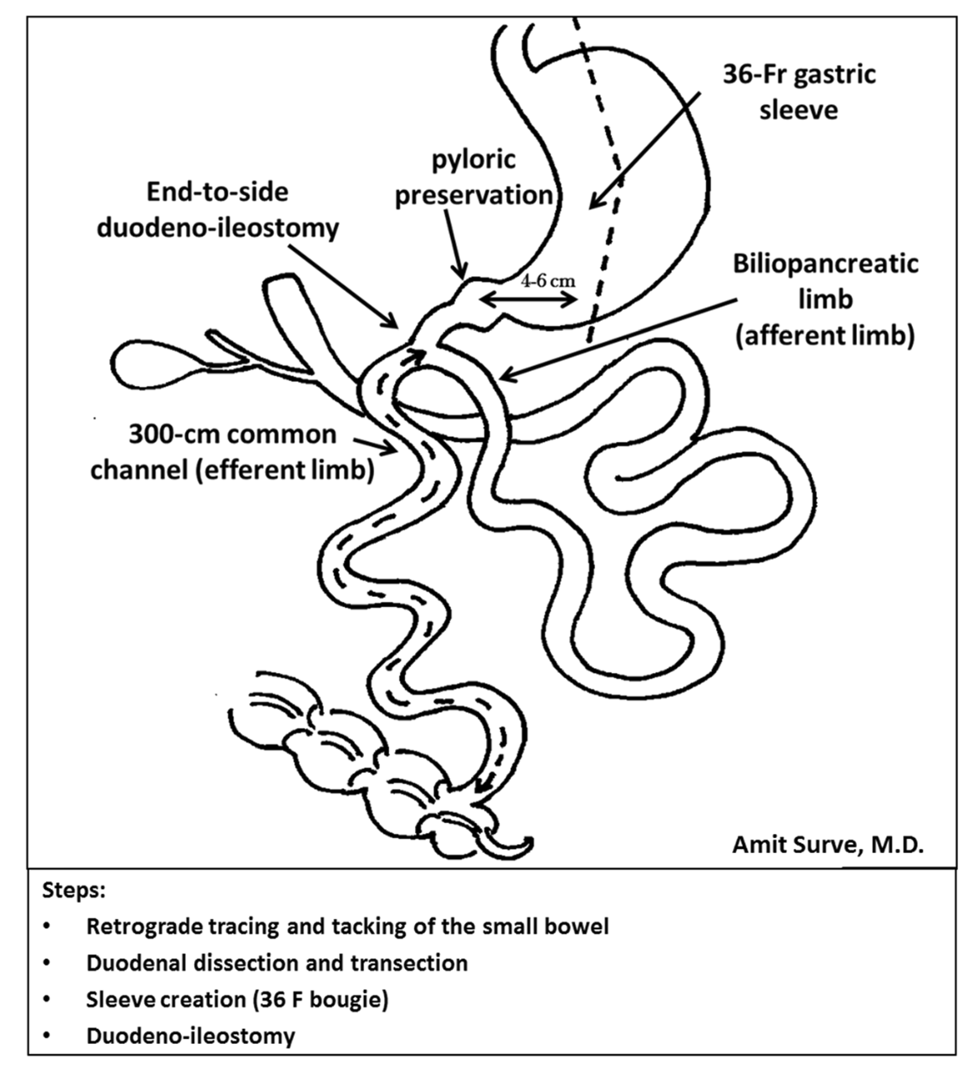
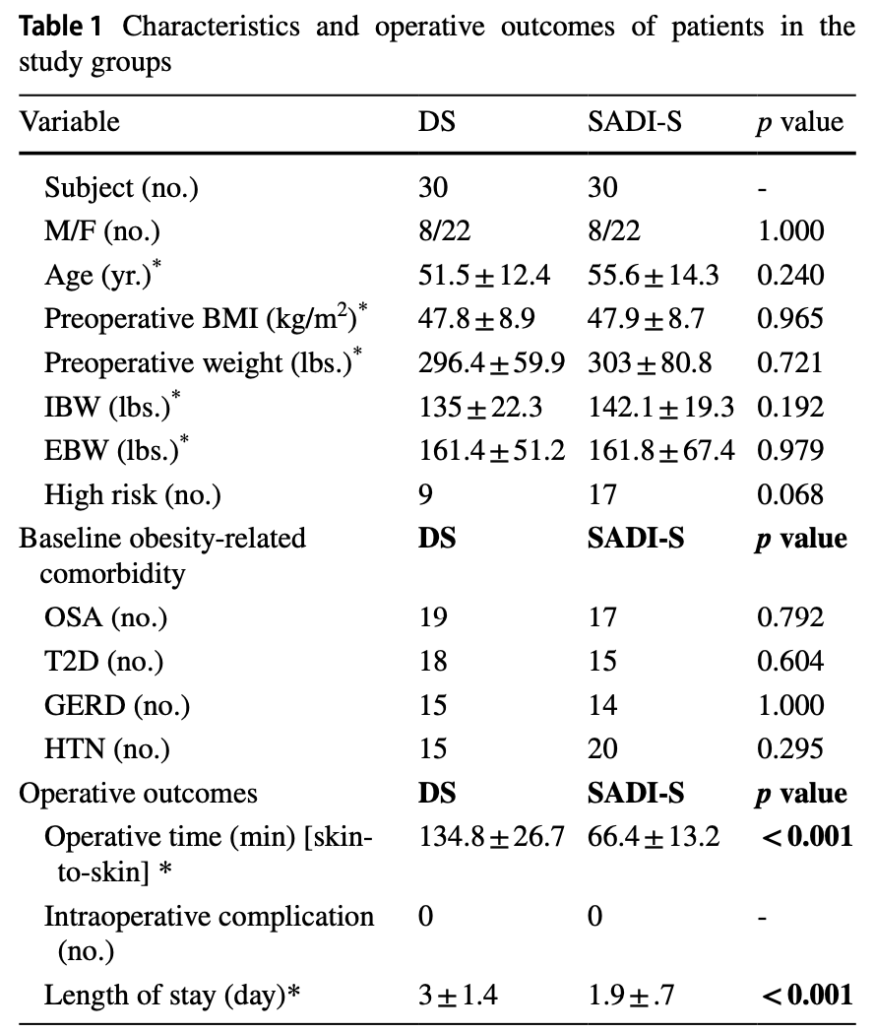
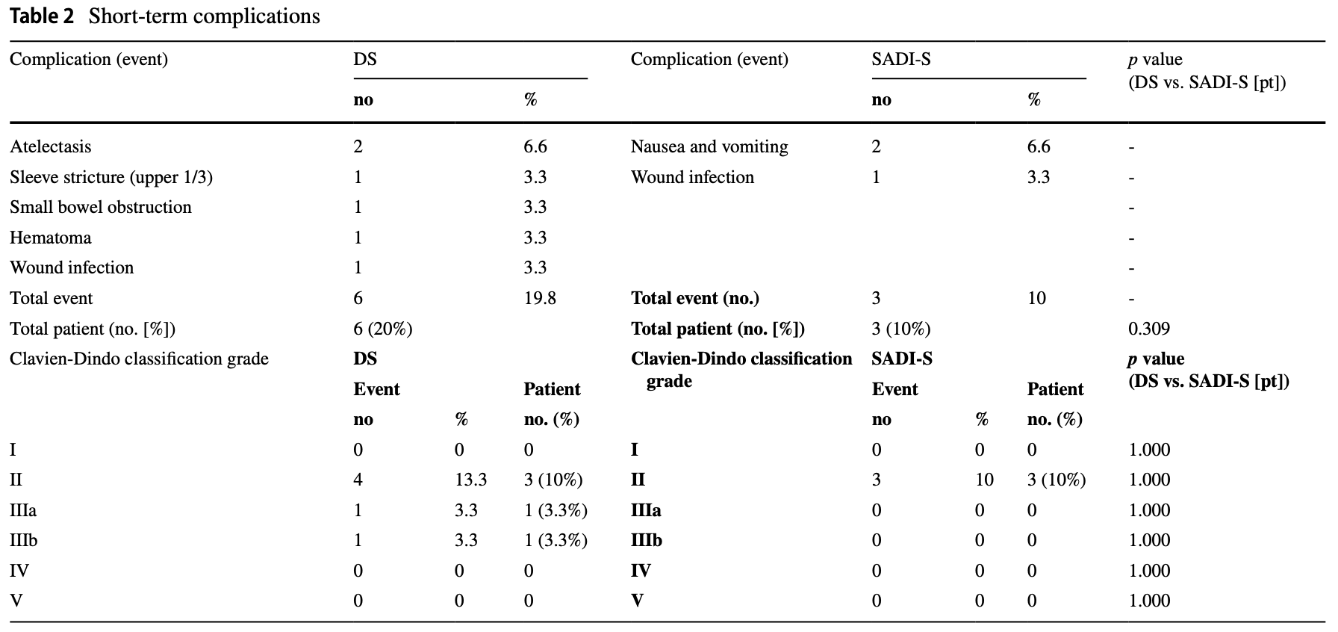

Slide 8
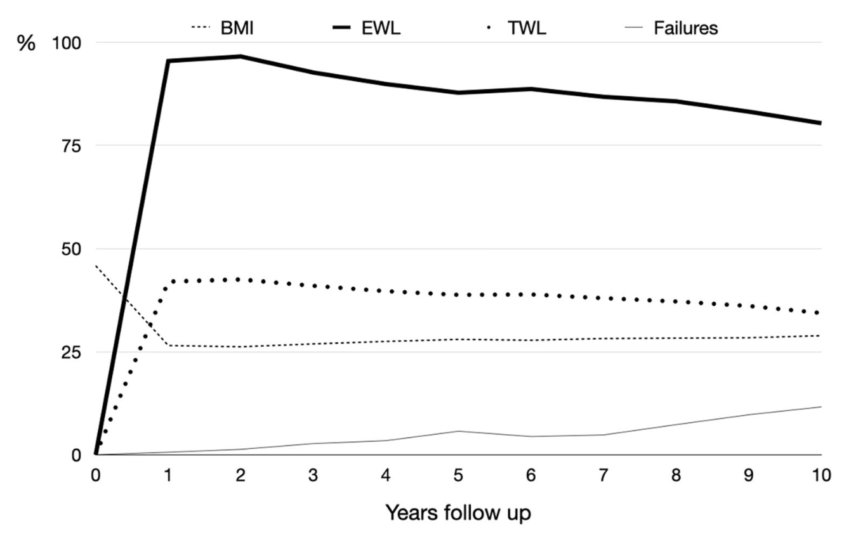
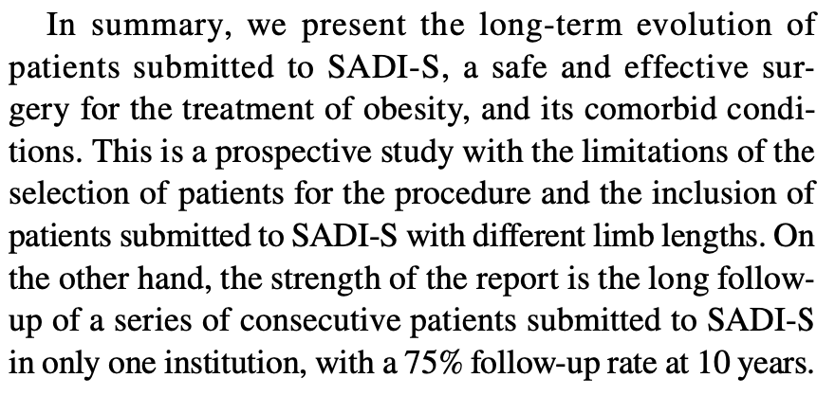
From May 2007 to December 2015, 164 patients were consecutively submitted to a one-step SADI-S.
Deficiencies detected are comparable to those reported by Himpens and Topart [19, 20] after the duodenal switch, by Scopinaro after the classical form of biliopancreatic diversion [23] or after the distal gastric bypass [24]. Excluding the initial series with a short common channel, the rate of revisional surgery for undernutrition was 4.3%.
The results of SADI-S on diabetics were expected as biliopancreatic diversions are the most powerful metabolic operations
SADI-S offers a greater and more stable weight loss in the long term than gastric bypass [31–33]. But more important is the absence of secondary complications requiring reoperation.

Slide 9
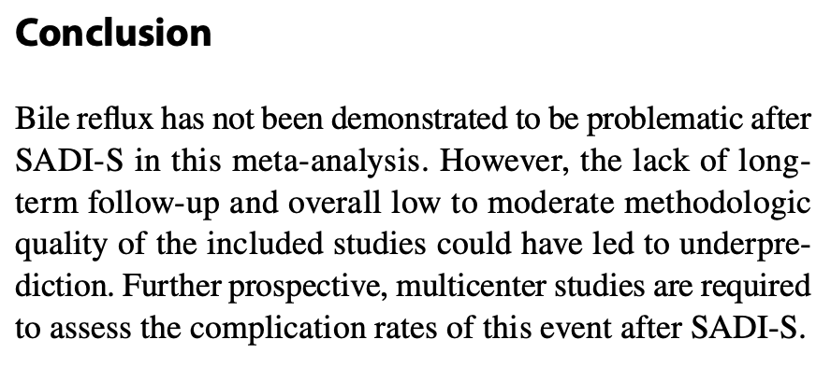
Compared the incidence of bile reflux in patients that underwent SADI-S and one anastomosis gastric bypass (OAGB), with the SADI-S group presenting an incidence of 4.8%, compared to 26.7% in the OAGB group. Thus, the reported incidence and event rate of bile reflux in SADI-S appears comparatively low and should not be prohibitive.
Results Out of 3,027 studies analyzed, seven were included. Studies were published between 2010 and 2020. Six out of 7 studies were retrospective. Three studies had a low risk of bias, three studies had a moderate risk of bias, and one had a high risk of bias. The mean follow-up was 10.3 months. The total number of patients was 2,029, with 25 reports of bile reflux, resulting in an incidence of 1.23%, with an event rate of 0.016 (95% CI 0.004 to 0.055).

Slide 10
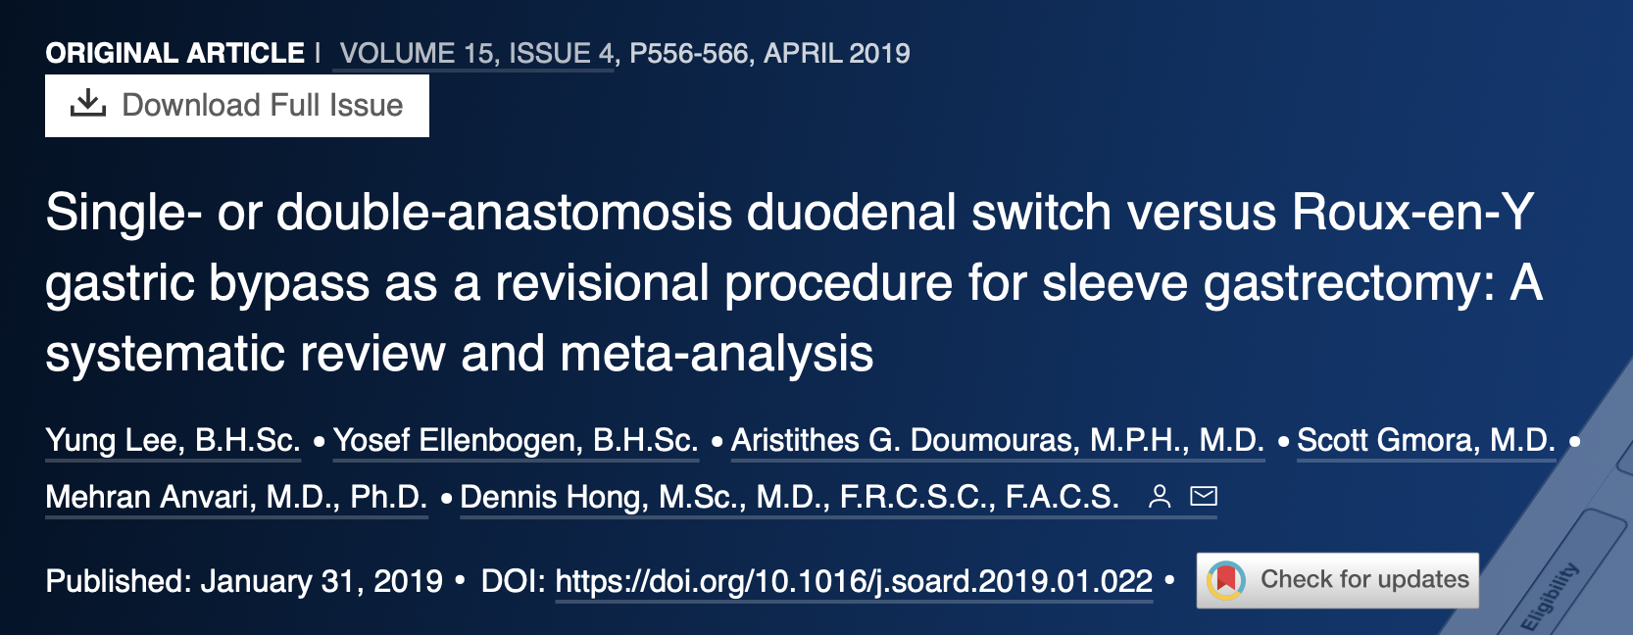
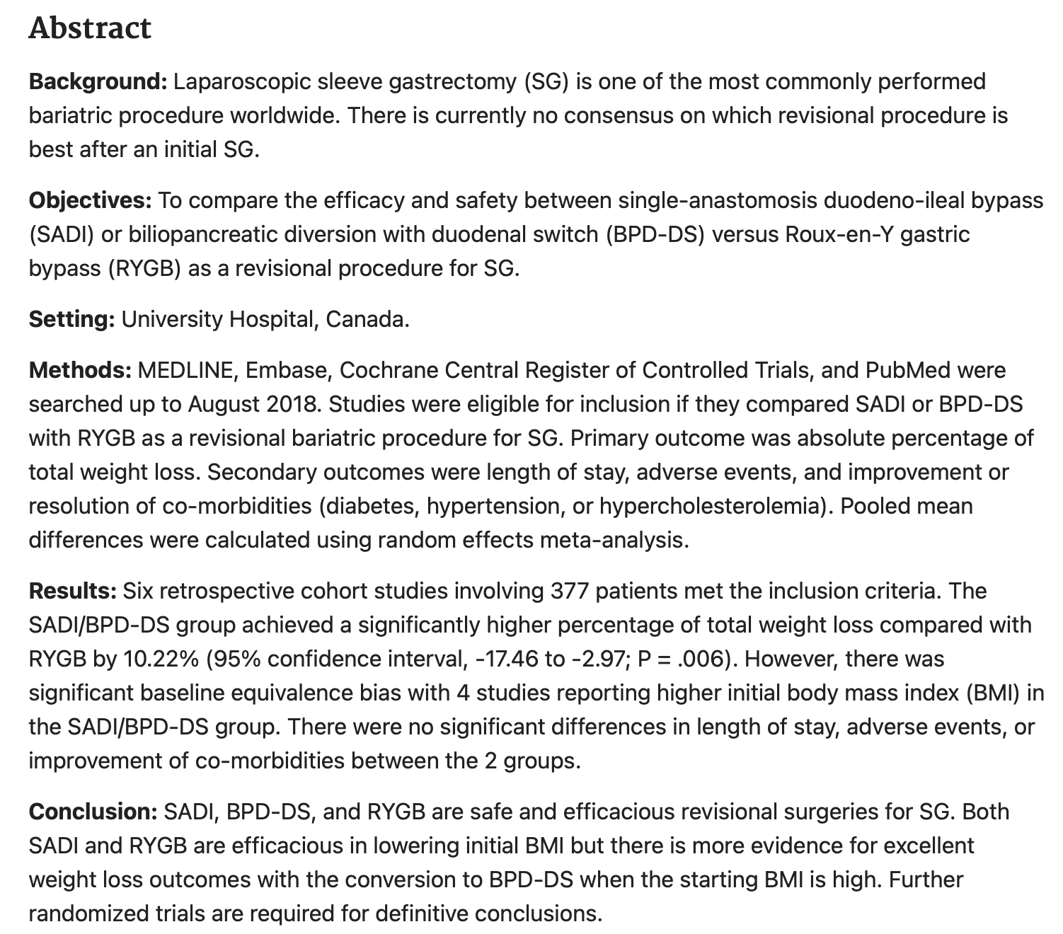

Slide 11
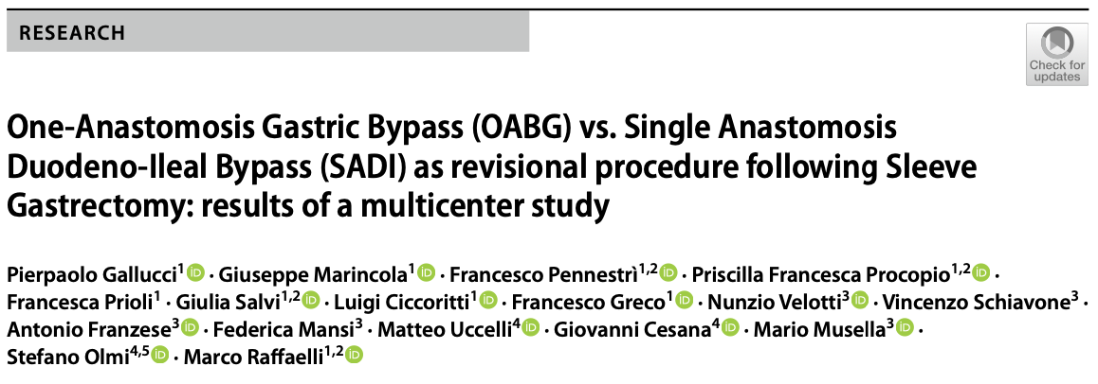
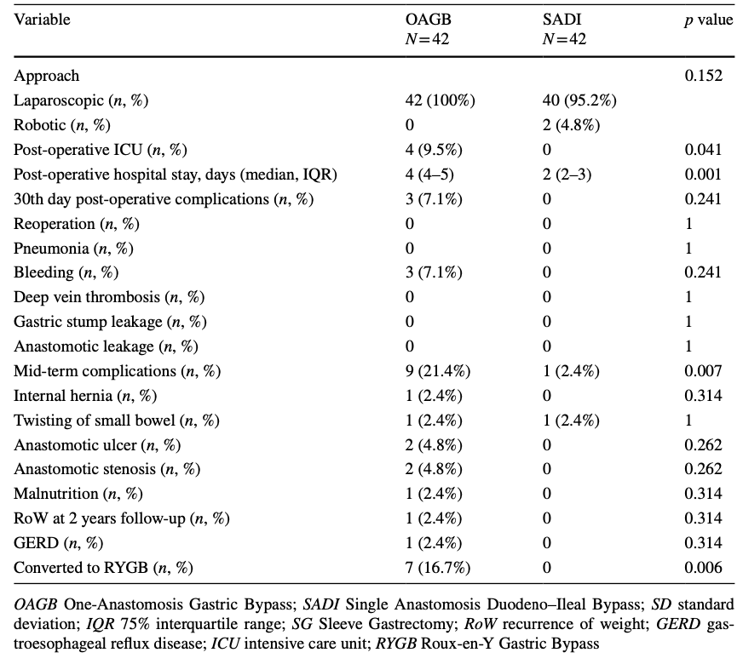

Slide 12
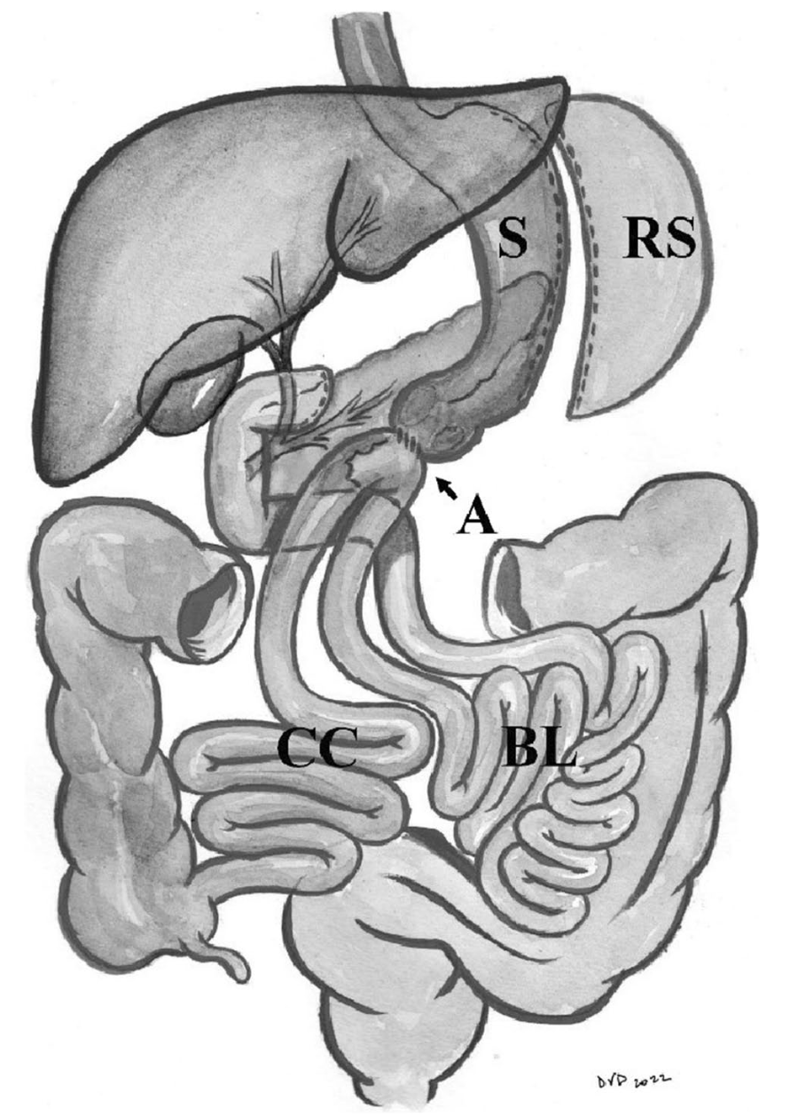
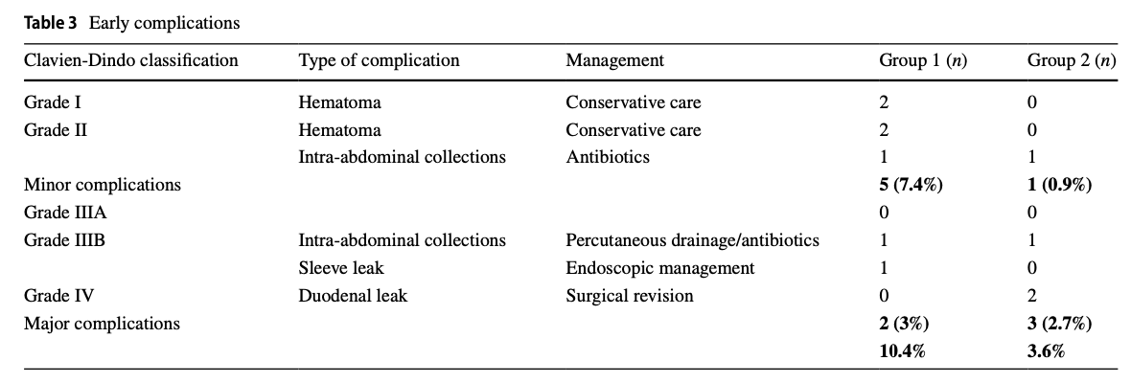
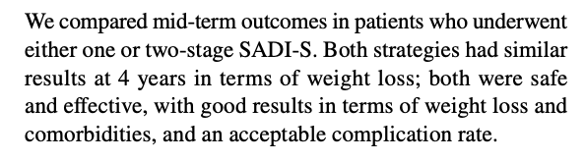
Purpose Compare primary single anastomosis duodeno-ileal bypass with sleeve gastrectomy (SADI-S) and two-stage SADI after sleeve gastrectomy (SG) in terms of weight loss, reduction/remission of comorbidities, and morbidity. Methods Retrospective study including 179 patients

Slide 13
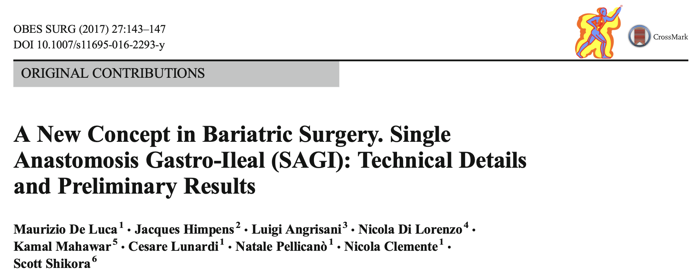
However, SADI-S, such as DS, requires transecting the duodenum which implies dissection of this structure and its inherent danger for the adjacent bile duct, pancreas, and major blood vessels. Injury to these structures may be life- threatening. In addition, anastomosis to the duodenum is technically difficult and complications such as leak and bleeding are difficult to control laparoscopically or endoscopically. Conversely, in OAGB or, as we propose, SAGI, the construction involves a gastro-jejunal anastomosis, which is easier to do than a duodenoileal anastomosis, and has a steep learning curve. Moreover, the laparoscopic and endoscopic management in case of leak and/or hemorrhage of the gastrojejunal anastomosis is easier. This is one of the main reasons that prompted us to choose the SAGI operation rather than the SADI-S.
In order to control the malabsorptive aspect of OAGB, we decided to measure the alimentary tract starting from the ileocecal valve and to adjust the name of the procedure to single anastomosis gastro-ileal bypass (SAGI). Hence, SAGI is very closely related to OAGB, with the difference that the gastro-enteric anastomosis is performed at 300 cm proximal to the ileocecal valve and no longer 180–250 cm distal to the angle of Treitz

Slide 14
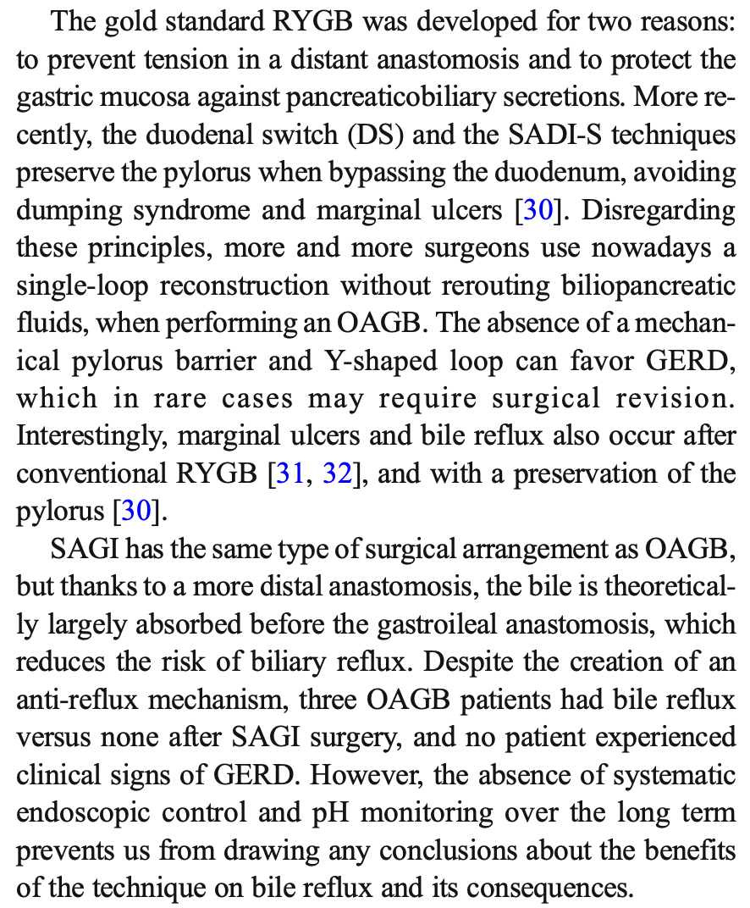
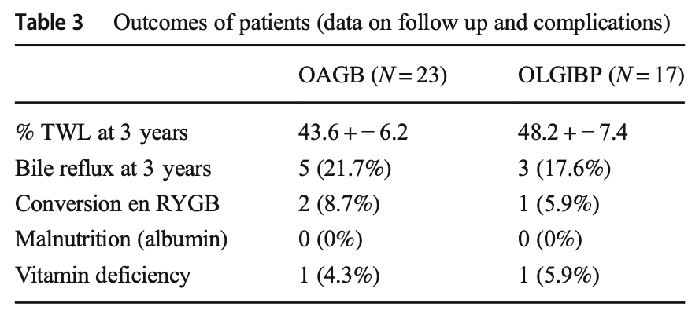
Material and Methods: To lower the complication rate and pathophysiological impact after OAGB, we performed an omega loop gastroileal bypass (OLGIBP/SAGI) with a 300-cm common limb. We compared this technique with OAGB.

Slide 15
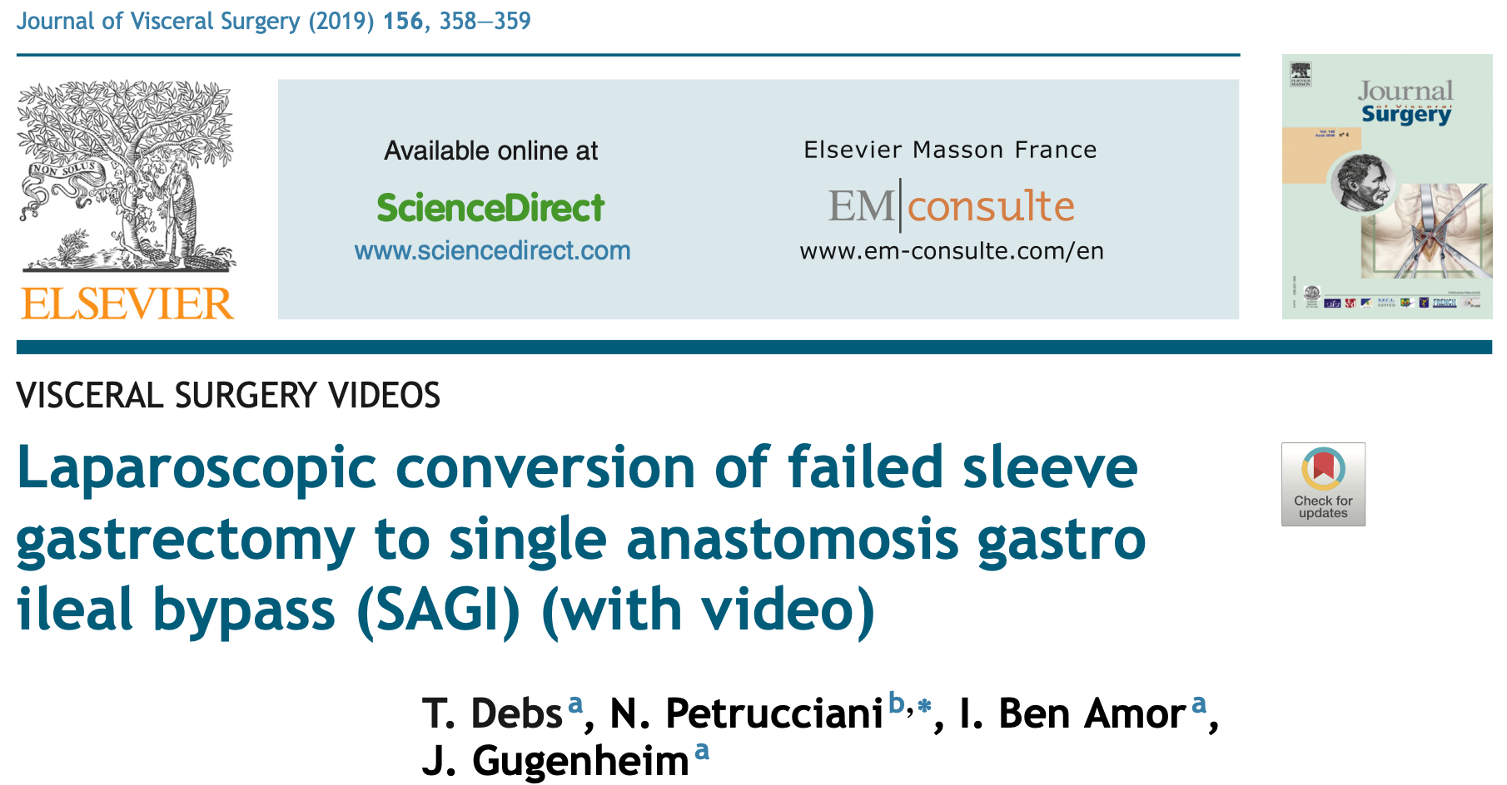
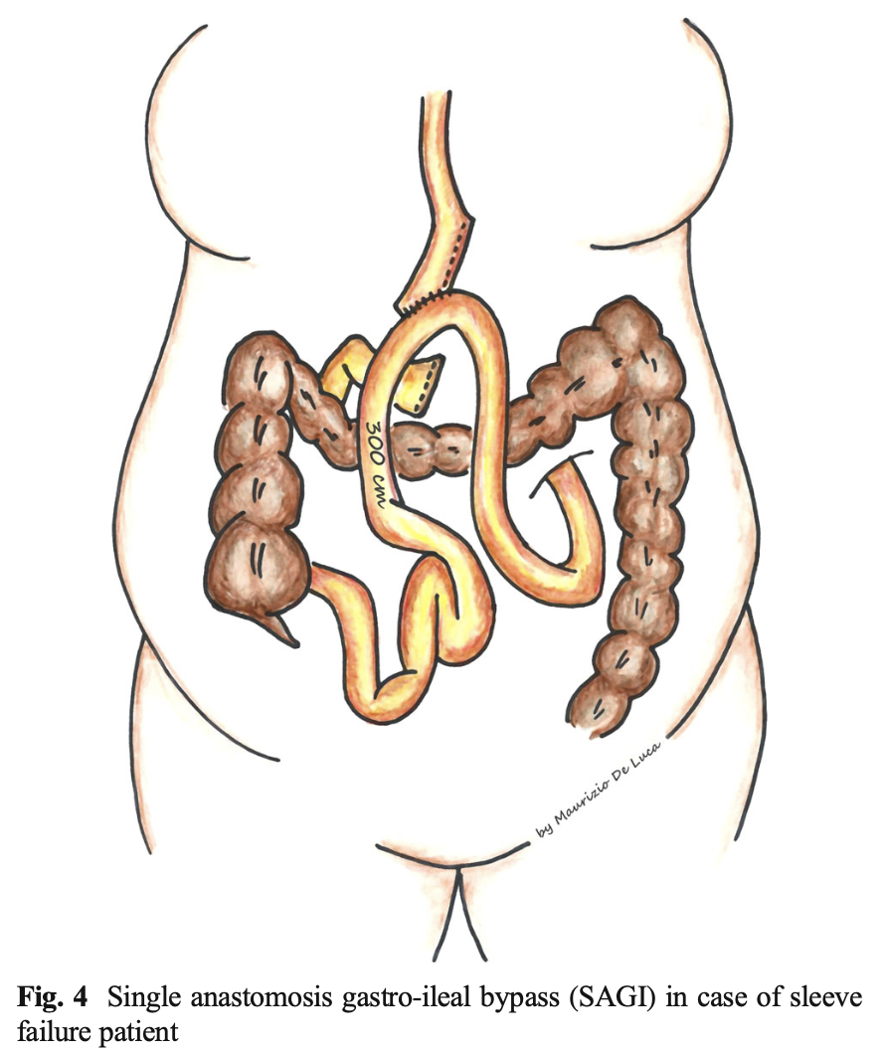
De Luca M, Himpens J, Angrisani L, Di Lorenzo N, Mahawar K, Lunardi C, Pellicanò N, Clemente N, Shikora S. A New Concept in Bariatric Surgery. Single Anastomosis Gastro-Ileal (SAGI): Technical Details and Preliminary Results. Obes Surg. 2017 Jan;27(1):143-147. doi: 10.1007/s11695-016-2293-y. PMID: 27431665.

Slide 16
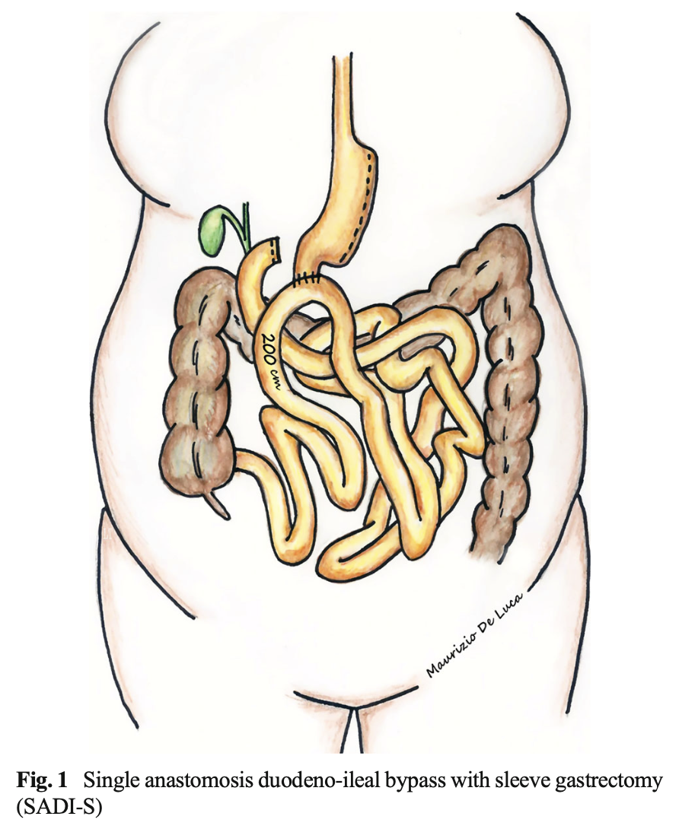
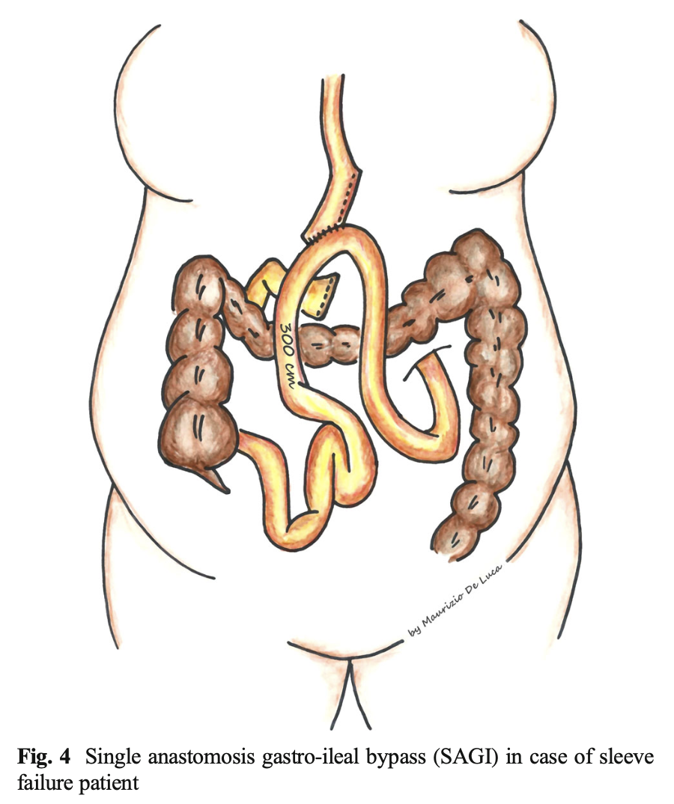
VS

Slide 17
PRO
Risultati paragonabili a RYGB a mid term, superiori long term
Rischio inferiore di ernie interne rispetto a RYGB
Una sola anastomosi (RYGB 2 anastomosi – tempi inferiori, rischi inferiori)
Su DM, risultati comparabili a diversione biliopancreatica, con minor malassorbimento
Non incrementa RGE / reflusso biliare (piloro) rispetto a OAGB
Risultati confermati anche nella chirurgia di revisione (post LSG)
CONTRO
Anastomosi tecnicamente difficile
Complicanze sia su anastomosi che su moncone duodenale / pancreas - VB

Slide 18
PRO
Alternativa a OAGB con miglior controllo del malassorbimento (ansa comune a lunghezza fissa)
Rischio inferiore di ernie interne rispetto a RYGB
Una sola anastomosi (RYGB 2 anastomosi – tempi inferiori, rischi inferiori)
Anastomosi GI rispetto DI
Complicanze anastomotiche (rispetto a SADI)
CONTRO
Tecnica più recente - Pochi dati / studi
Reflusso biliare
Ulcera anastomotica
Conversione a RYGB

Slide 19
VS

Slide 20
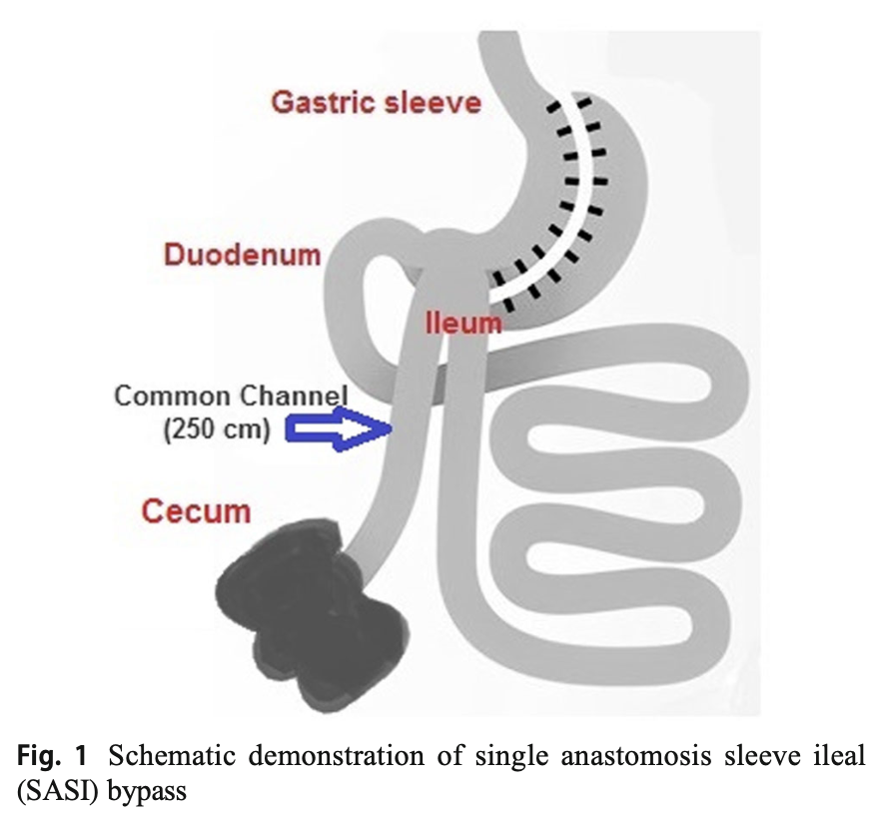
VS

Slide 21
Grazie

